Slide 1


Optimizing sales and analyzing shopping trends of “Needs Corner”
A Presentation for BDM Capstone Project
INDIAN INSTITUTE OF TECHNOLOFY MADRAS, CHENNAI
TAMIL NADU, INDIA, 600036
(BS) DEGREE IN DATA SCIENCE AND APPLICATIONS
Presented By-
Atharva Garajkar
Roll number: 22f1000699

Slide 2
Executive Summary
☆ Project Objective --> Analyze sales data of Needs Corner to identify way for maximizing profitability and increasing revenue, supporting the owner's goal of expanding the business.
☆ Organisation in review --> A B2C General store, Needs Corner provides a wide range of products.
☆ Methods --> Profitability analysis, and customer segmentation techniques
☆ Outcome --> Generate data deiven output and Recommendation to increase profit.

Slide 3
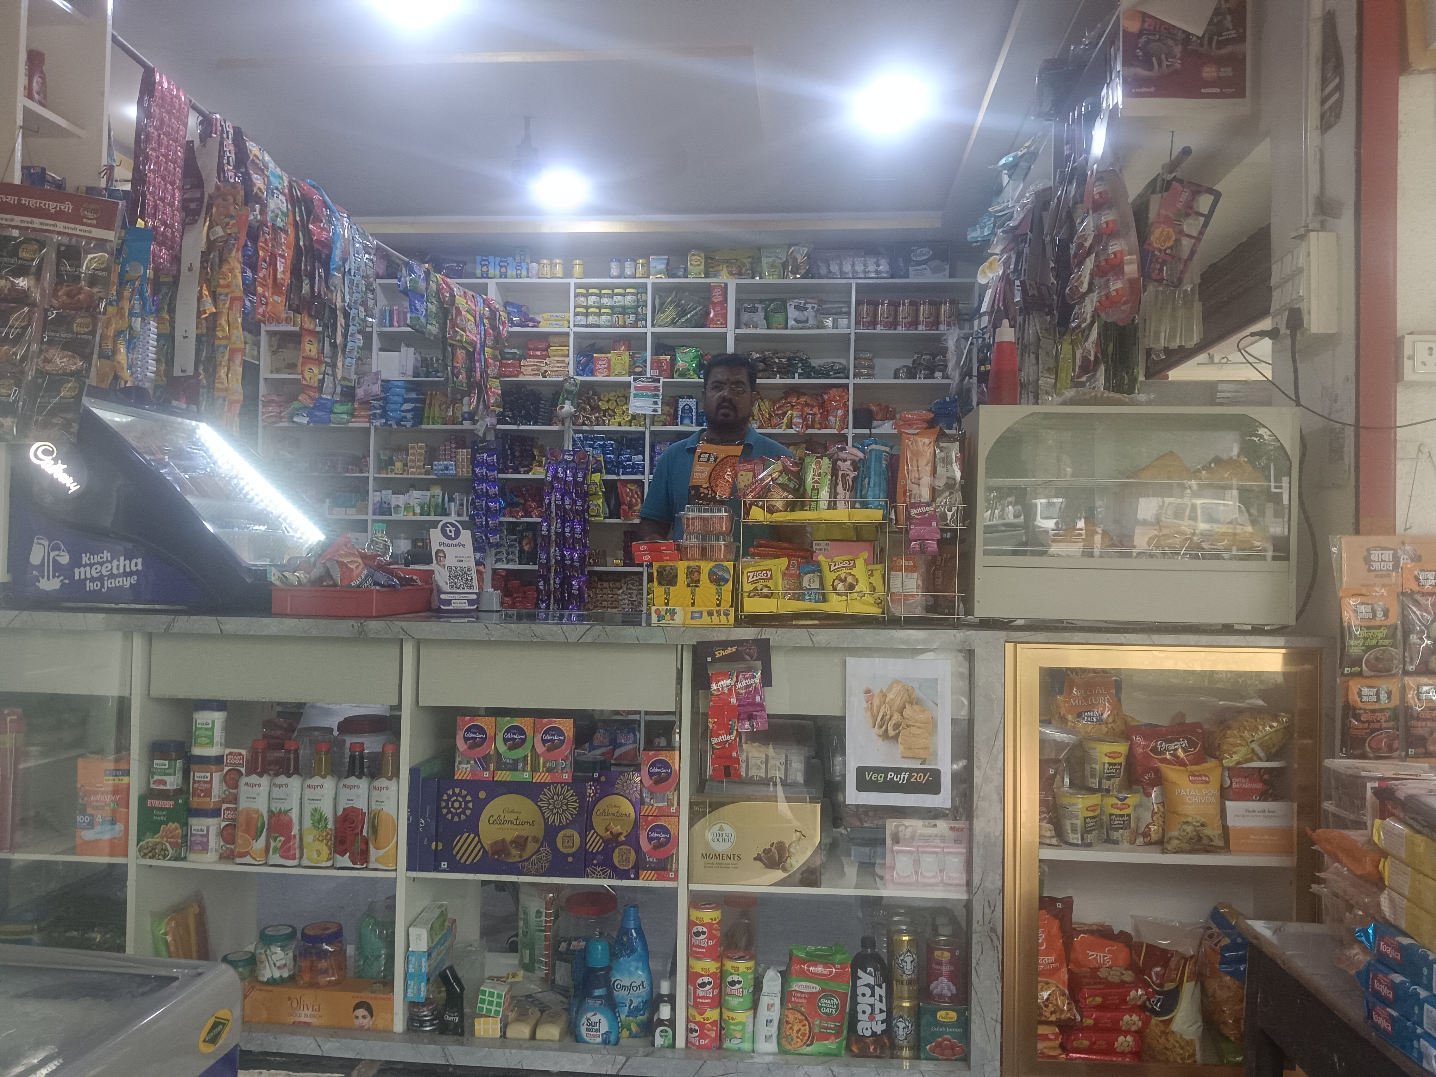
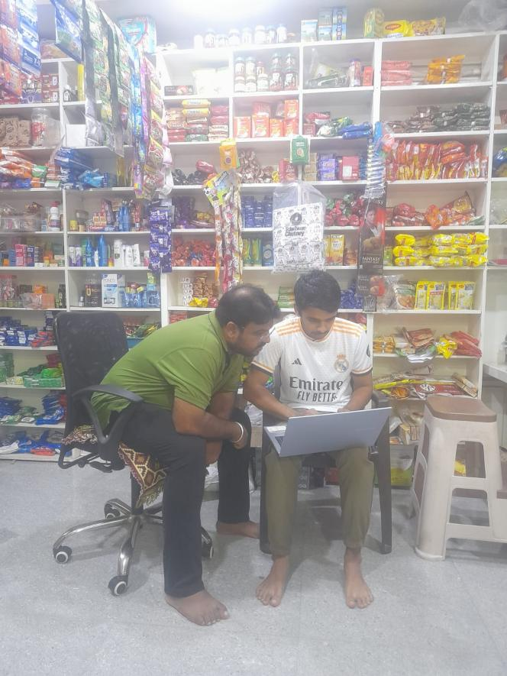
NEEDS CORNER
Medium Sized General Store in Maharashtra
Established in 2021
1 Employee (Owner)
Monthy revenue - Avg 8 Lakhs
Data collection -
Rough books and Receipts
Contribution of owner
Tools used - Excel- Pivot tables, Graphs

Slide 4
Problem Statements
☆ Problem statement 1: To identify the price trends in the sales data, buying frequency and purchaser behavior
☆ Problem statement 2: The shop faces inconsistent sales of dairy products. Which results in no profit for them.
☆ Problem statement 3: To analyze the inventory management during certain times of a month, and also the slow moving stocks which holds a lot of space.

Slide 5
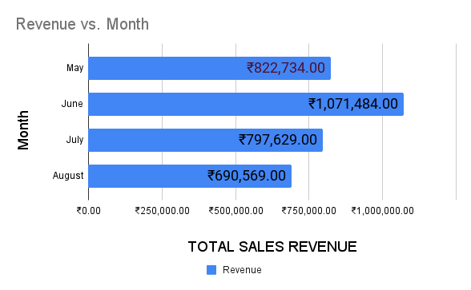
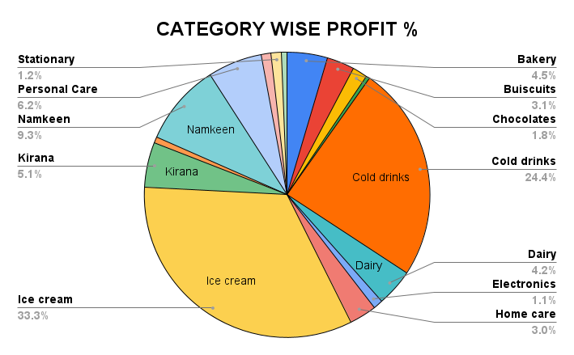
Data Analysis
The bar graph illustrates the shop's monthly revenue distribution. Notably, the highest revenue was recorded in June, followed by May, July, and August in descending order.
The significant increase in revenue can be attributed to the high sales of the shop's best-selling ice cream, which experiences peak demand during the month of June.

Slide 6
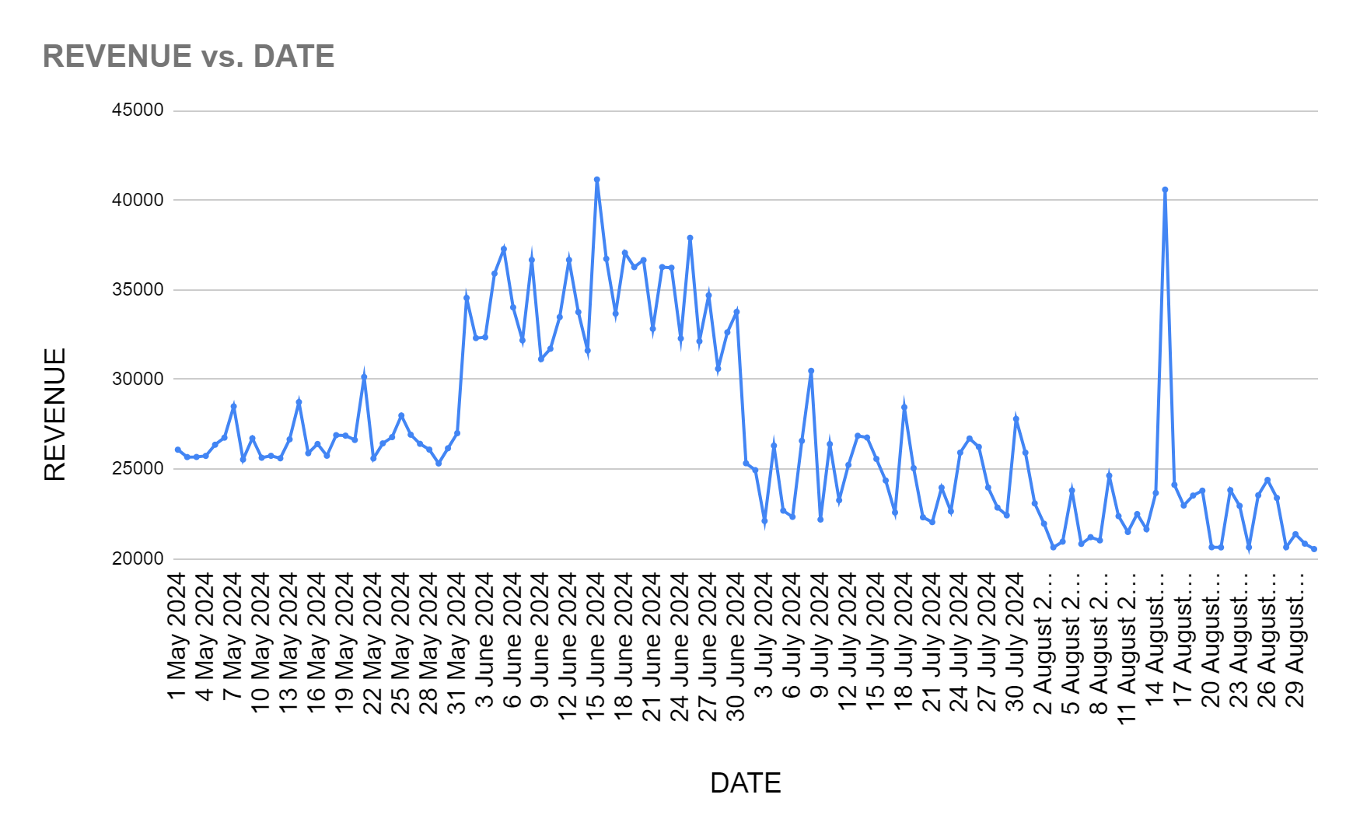
Data Analysis
Profitability analysis -->
Pareto analysis -->
The Pareto chart reveals that, unlike the typical 80/20 rule, 80% of the revenue in this case comes from the top 40% of items, with ice cream being the largest contributor, accounting for 33.33% of the total revenue.
The day-wise profitability analysis shows a sales spike around July 15th and August 15th, driven by students from the nearby school purchasing stationery and toffees during events like Independence Day and school reopenings.

Slide 7
Key Findings
☆ The sales exhibited a marked exponential increase around mid-June (15th June) and mid- August (15th August), indicating significant growth during these periods
☆ The majority of our customers are children because of the school.
- Revenue can be substantially increased by targeting this segment.
Closing Balance | May | June | July | August
Dairy | 289 | 241 | 206 | 206
☆ Wastage of Dairy Products
- This wastage Results in no profit in the Milk section ,
Sometimes resulting in loss
☆ Poor Inventory management
- Slow moving items occupy large space
- Some chocolates are kept backshelf where they can’t be seen by kids.

Slide 8
Interpretation of Result and Recommendations
☆ Prioritize high selling Products like Namkeen, Ice-cream Than dairy products
- Smart Inventory Management.
☆ More focus on Seasonal and Festive Items.
☆ Develop Customer Loyalty program - Slow moving items to the most loyal customers.
☆ Start Quick fast food like Veg Puff and Vada Pav.
☆ Collaborate with the school.
☆ Home Delivery for the locals.
☆ Find Children’s Fav namkeen before the competition does.
☆ Making Tea with the remaining milk.

Slide 9
Expected Outcome & Conclusion
☆ Embracing a data-driven approach has unveiled actionable insights for Needs Corner, enabling increased profitability, optimized operations, and a competitive edge in the local market.
☆ Implementing the recommended strategies is expected to drive significant outcomes: 15-20% boost in overall profitability within the first year
☆ Improved inventory, turnover and reduced holding costs
☆ With a solid foundation laid by this project, Needs Corner is well-positioned to achieve its expansion goals and maintain a strong competitive advantage in the local market.

Slide 10
THANKS

